Slide 1
TESTING & STANDARDIZATION PANEL SESSION: SPEC PROPOSAL FOR NANOCRYSTALLINE CMC
José Gató
August 2023

Slide 2
NANOCRYSTALLINE IS THE MATERIAL FOR FUTURE ELECTRIFICATION
Nanocrystalline material vs Ferrite
CONTENT CANNOT BE USED WITHOUT PERMISSION
Material | Nanocrystalline (VITROPERM®) | Ferrite
Material base | ~ 70% Fe | MnZn (NiZn)
Coercivity H_{c} [A/m] | <3 | 5....60 (....2000)
Losses P_{Fe,ty p.} [W/kg] 100 kHz, 300mT, 100°C | 60…90 (VP500) 40…50 (VP550HF) | 140
Saturation flux density B_{s} [T] | > 1.2 (room temp.) ca. 1.1 (120°C) | < 0.48 (room temp.) ca. 0.3 (120°C)
Initial permeability µ_{i} | 2000....200 000 | 10....10 000 (20000)
Saturation magnetostriction λ_{s} | 10⁻⁷ …10⁻⁸ | 10⁻⁶....2×10⁻⁵
Max. operating temp. T_{op} | plastic case 130°C* core 155°C, 180°C (short time) | < 100°C (120°C)
Curie temperature [°C] | > 600 | 150…200

Slide 3
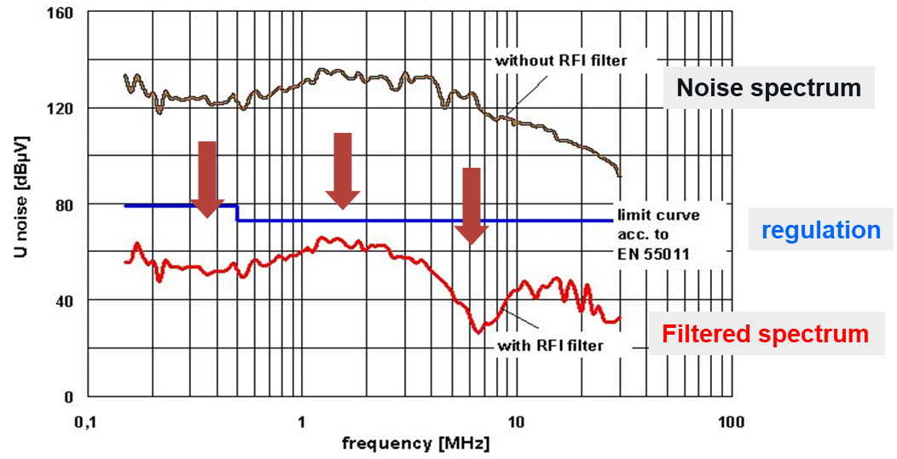
WHAT’S NECESSARY IN A CMC?
CONTENT CANNOT BE USED WITHOUT PERMISSION
How much attenuation of noise is needed? Required impedance
Over what frequency bandwidth is the noise? Required frequency range
How much current must it handle? Required current handling
I Z I and L measurement in a normal Impedance Analyzer provides the basic information to calculate permeability, power losses, etc.
Proposed range to measure is 100Hz thru 100MHz (ferrites can’t effectively function as CMC above 2MHz without significant limitations in size, DC tolerance, temperature dependence, etc.).

Slide 4

FREQUENCY DEPENDENCY OF PERMEABILITY
CONTENT CANNOT BE USED WITHOUT PERMISSION
1/$\sqrt{f}$ (Eddy Current)
1/f (gyromagnetic)

Slide 5
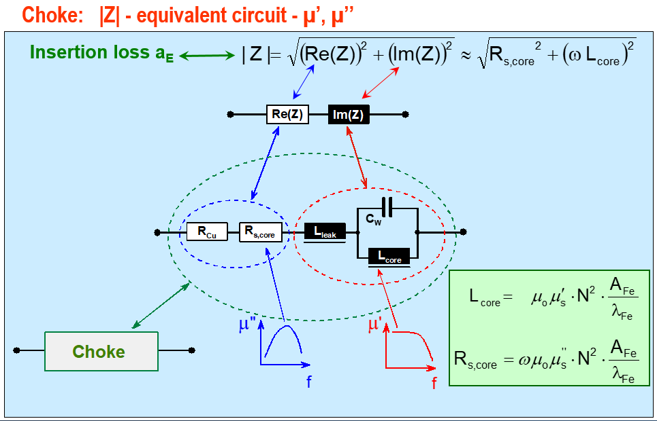
COMPLEX IMPEDANCE IN A CHOKE
CONTENT CANNOT BE USED WITHOUT PERMISSION

Slide 6
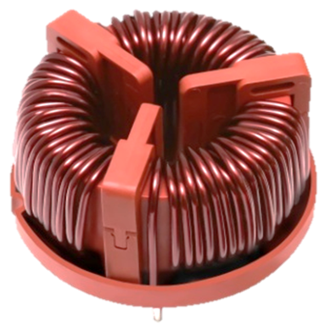
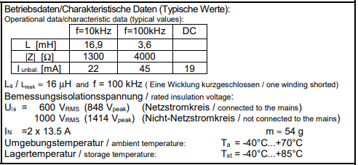
SPEC RECOMMENDATION (PART 1)
VAC recommendation is to measure IZI (complex impedance) and L (inductance) between 100Hz and 100 MHz
CONTENT CANNOT BE USED WITHOUT PERMISSION
L (10 kHz) → comparison with ferrite
L (100 kHz) → real focus for the application
IZI (f) → insertion loss can be calculated
Ls (Leakage inductance) → interesting to understand the DM attenuation (usually better in ferrites)
I_{unbal} (DC, 10kHz, 100kHz)
Extracted from an existing VAC datasheet

Slide 7
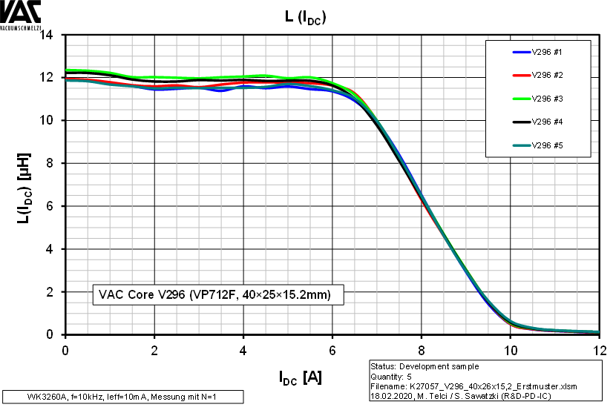
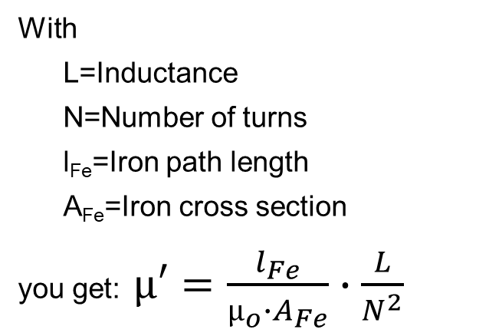
SPEC RECOMMENDATION (PART 2)
The graph L vs DC current bias must be as rectangular as possible (optimized performance). This graph helps calculate permeability:
CONTENT CANNOT BE USED WITHOUT PERMISSION
With
L=Inductance
N=Number of turns
l_{Fe}=Iron path length
A_{Fe}=Iron cross section
you get: $µ′=\frac{l_{Fe}}{µ_{o}∙A_{Fe}}∙\frac{L}{N^{2}}$
Maximum common mode current can be calculated from 70% of value at (Idc = 0)

Slide 8
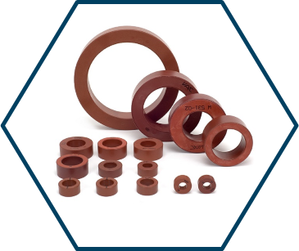
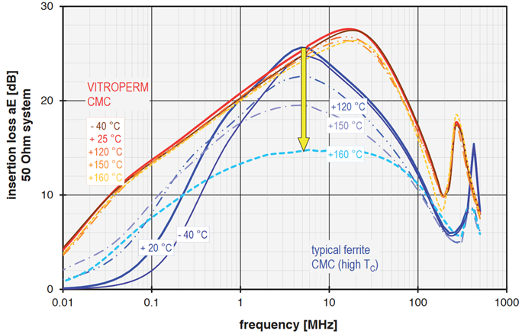
SPEC RECOMMENDATION (PART 3)
Further recommendations to specify a superior solution…
CONTENT CANNOT BE USED WITHOUT PERMISSION
Include a tighter tolerance +/- 6%:
For core weight
For A_{fe}
The purpose is to reduce the scattering of the filling factor and tight the inductance range.
An excellent CMC should be able to reach higher DC tolerances for the same amount of material.
The narrower the temperature dependency of the magnetic characteristics, the better performance the CMC will show across the temperature range. Interesting hint for the designer to make a good selection.

